Slide 1
Object detection in x-ray images
Group Name: Oasis
Group members:
Nattapat Juthaprachakul, Rui Wang, Siyu Wu, Yihan Lan

Slide 2
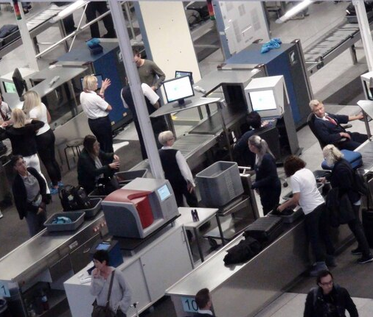
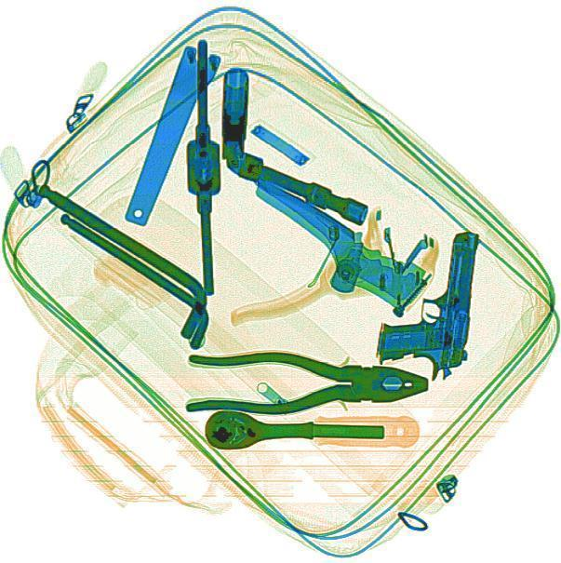
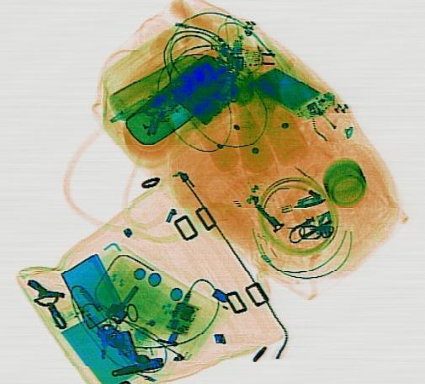
Motivation and Goals
Detect prohibited items in X-ray images
Find the best Algorithm that solve this problem
Train multiples models and compare their performances

Slide 3




Tools
Tensorflow Object Detection API
Google Cloud Platform

Slide 4
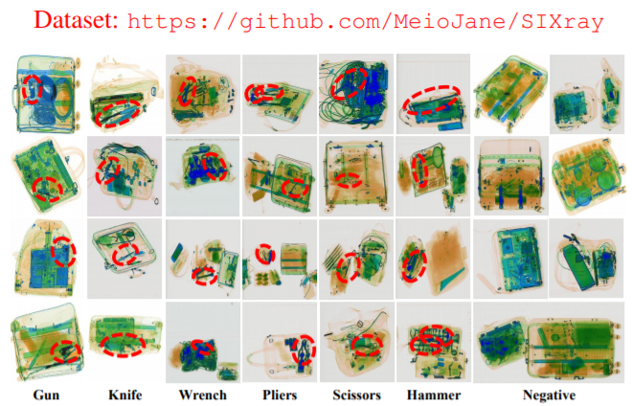
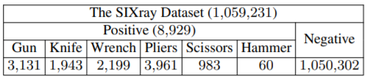
SIXray Dataset
X-ray Images collected from several subway stations by University of Chinese Academy of Sciences
Image resolution
1000 x 1000
Drop Hammer class

Slide 5
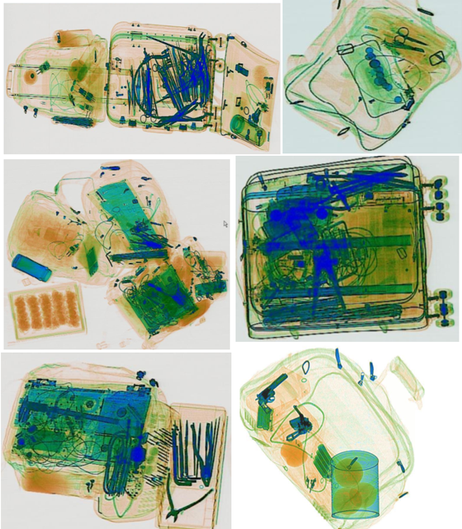
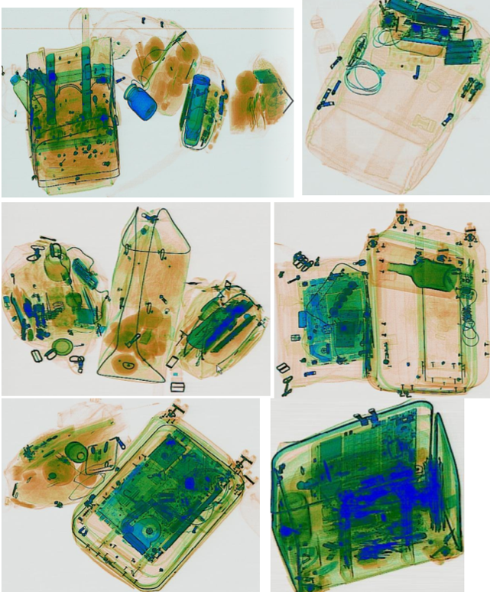
Challenges
1. Big Unbalanced Dataset:
9,000 Positive samples
vs
1,000,000 Negative samples
2. Challenging Images:
- Unclear
- Clustering
- Overlapping
Positive (Prohibited objects)
Negative

Slide 6
Data Science Pipeline
Obtain Dataset
Pre-process image and label files to create Train dataset
Create Training pipeline and Training models
Evaluate models with Test dataset
Visualize and compare performance for each model
Test set
1.) 1.8k Positive samples + 50k Negative samples
2.) 1.8k Positive samples + 100k Negative samples
3.) 1.8k Positive samples + 150k Negative samples
Train/Val set
7.2k Positive samples

Slide 7
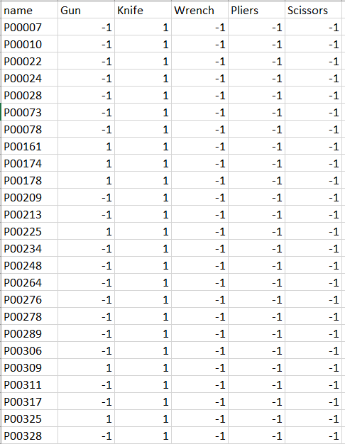
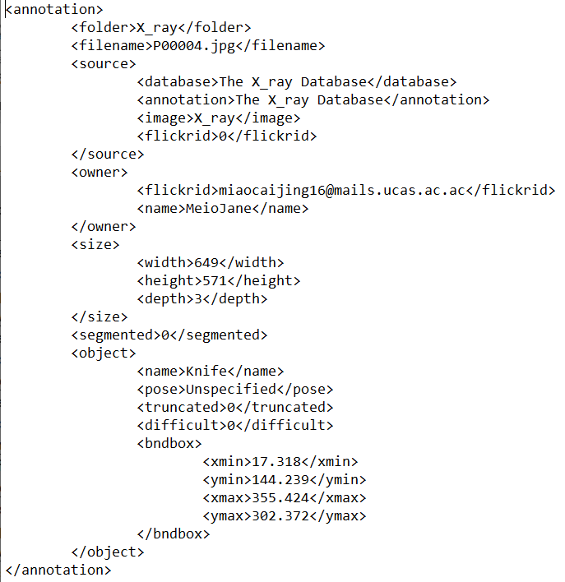
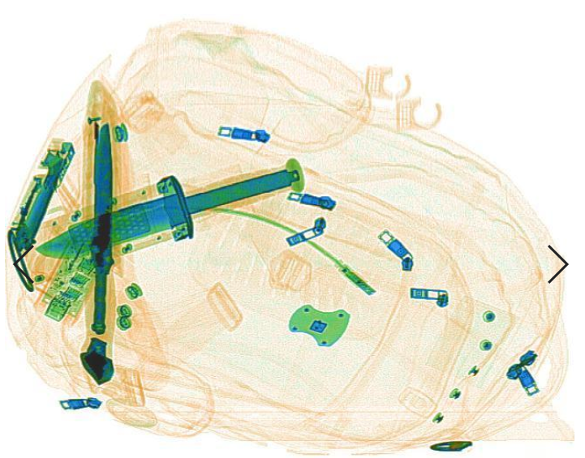
1. Obtaining Dataset
Download from SIXray Github
Dataset contains:
1. Positive sample images
2. Negative sample images
3. Label csv files
4. Location annotation files of positive sample

Slide 8
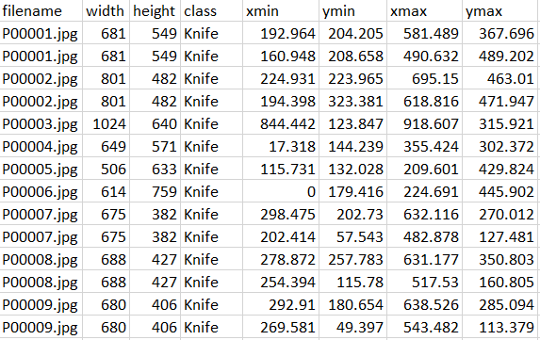
2. Pre-process images and label files to create training data
2.1 Get correct labels for each image (since we use only subsets of images)
2.2 Combine annotated location and label files into one csv file (picture)
2.3 Create Training data by combining file 2.2 with actual images to create Tensor Records

Slide 9
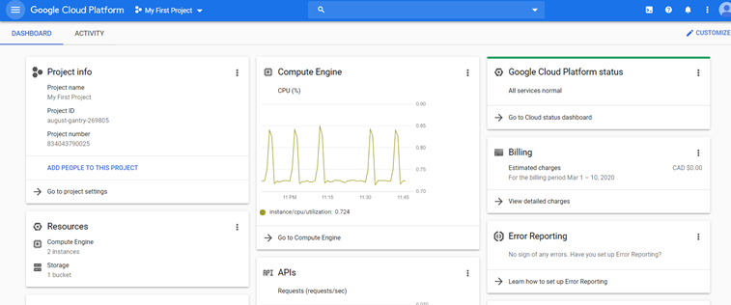
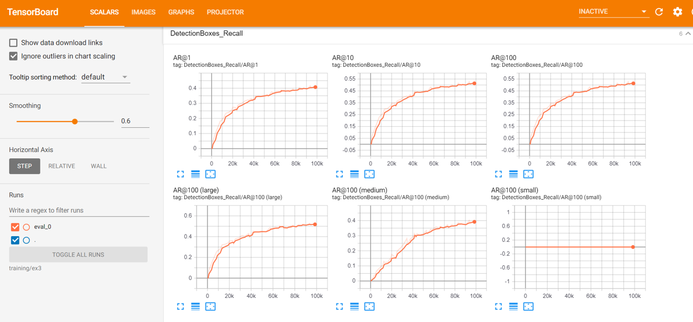
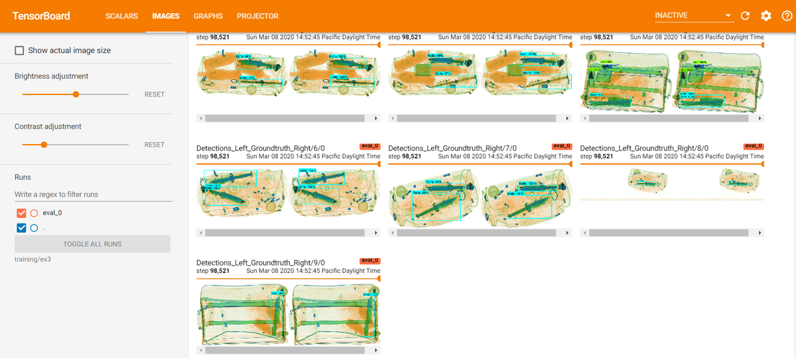
3. Creating Training pipeline and training models
Set up training pipeline on Google Cloud Platform (GCP)
Set model configurations
Train model on GCP with GPU
Monitor progress through Tensorboard

Slide 10
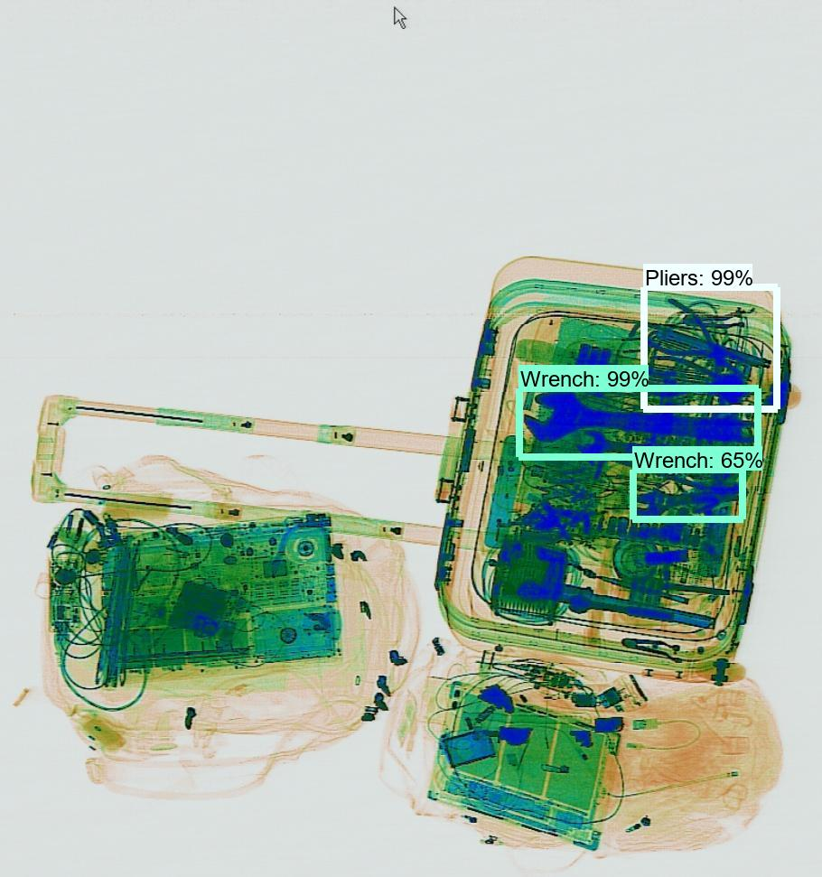
4. Evaluating models
Create Inference graph from model checkpoint + metadata
Evaluate each model(Inference graph) with different ratios of Negative-Positive test datasets
Test set
1.) 1.8k Positive samples + 50k Negative samples
2.) 1.8k Positive samples + 100k Negative samples
3.) 1.8k Positive samples + 150k Negative samples
8 Object Detection Models

Slide 11
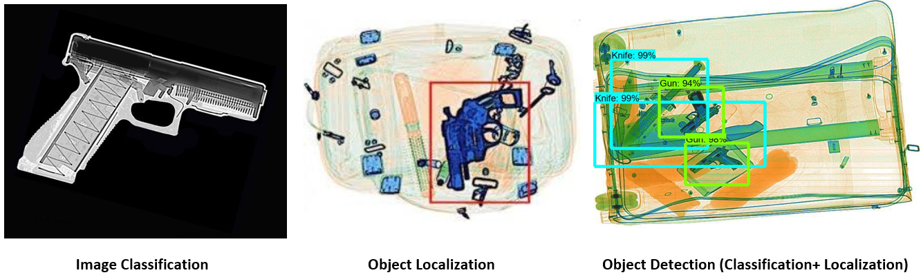
Methodology: Object Detection
Models (Detection + Base Network)
Faster R-CNN + Inception v2
Faster R-CNN + Resnet50
Faster R-CNN + Resnet101
SSD + Inception v2
SSD + Resnet50
SSD + Mobilenet v1
SSD + Mobilenet v1 (FPN)
RFCN + Resnet101

Slide 12
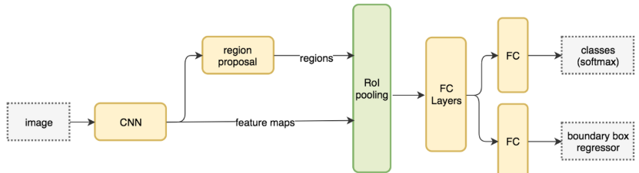
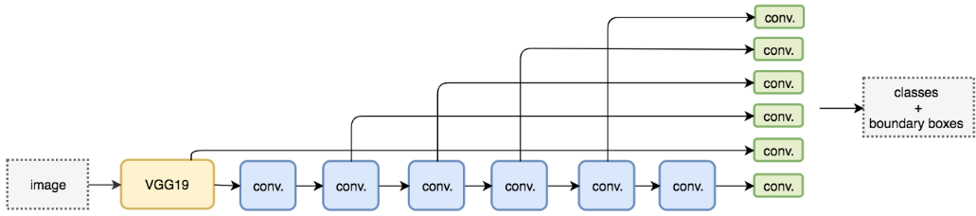
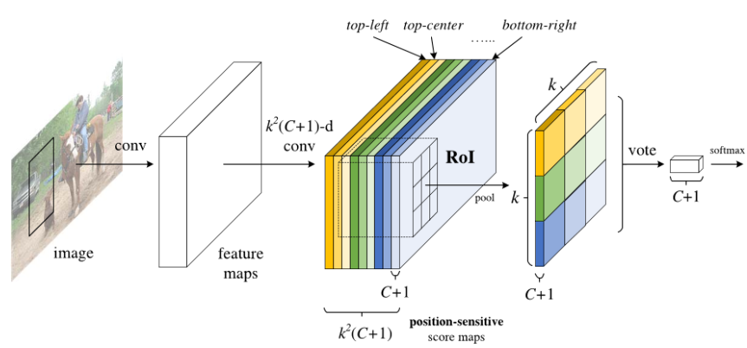
Key differences for each model
Faster R-CNN (Region-based model)
Use Region Proposal Network to generate regions of interests
Slow but very accurate
SSD (Single Shot model)
Predict both bounding boxes and classes at the same time
Fast but not accurate for small objects
R-FCN
Predict both bounding boxes and classes at the same time
Use Position-sensitive score maps
Combine architectures from both SSD and Faster R-CNN

Slide 13
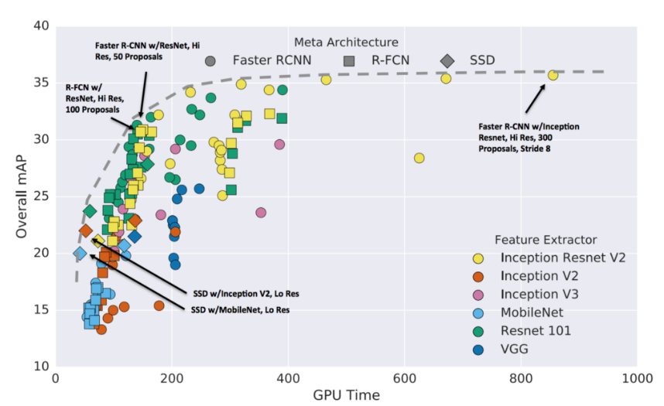

Slide 14
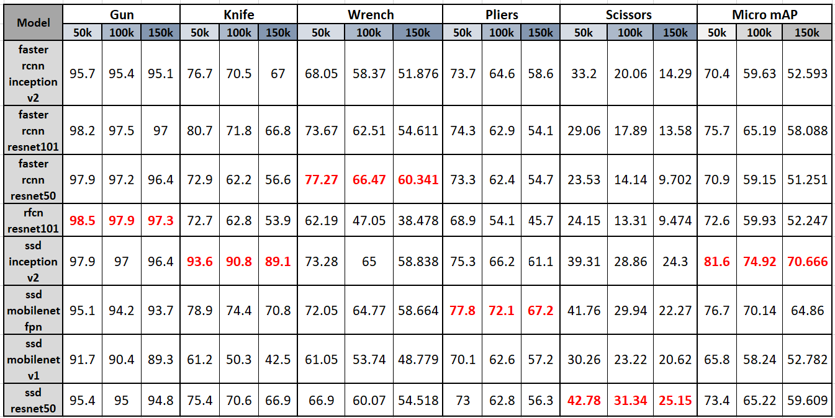
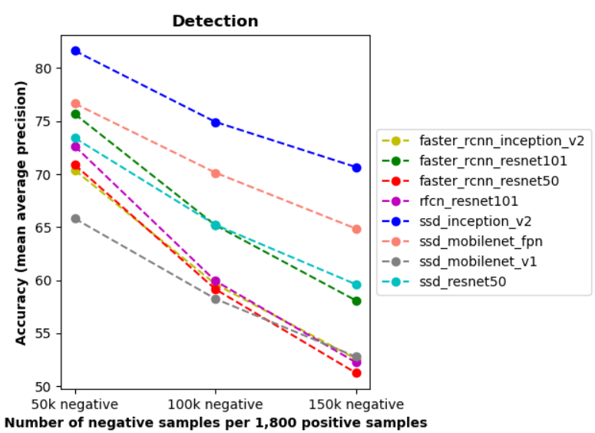
Results
Test sets
1,800 Positive samples + 50,000 Negative samples
1,800 Positive samples + 100,000 Negative samples
1,800 Positive samples + 150,000 Negative samples

Slide 15
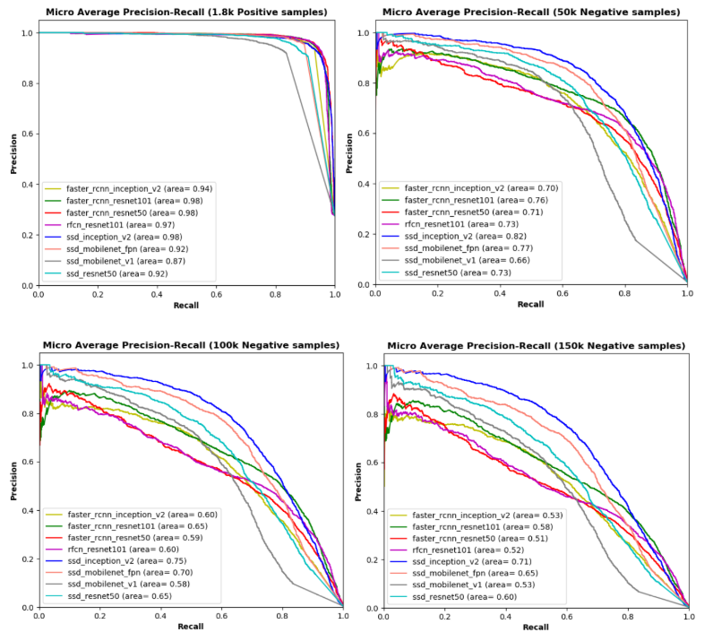
Results
Micro Average Precision-Recall curves
Suitable for imbalanced dataset and classes

Slide 16
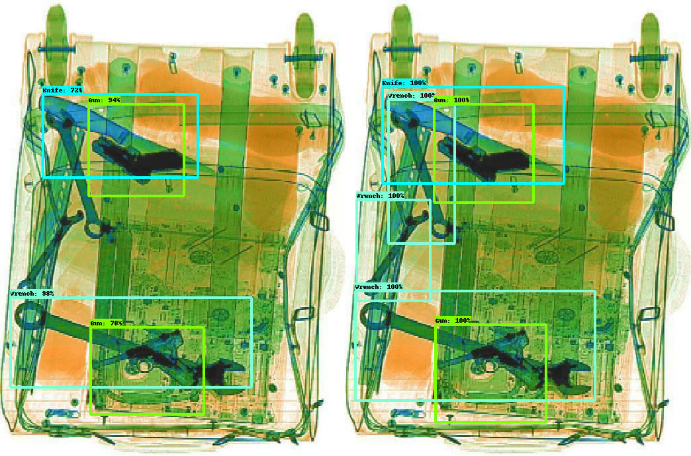
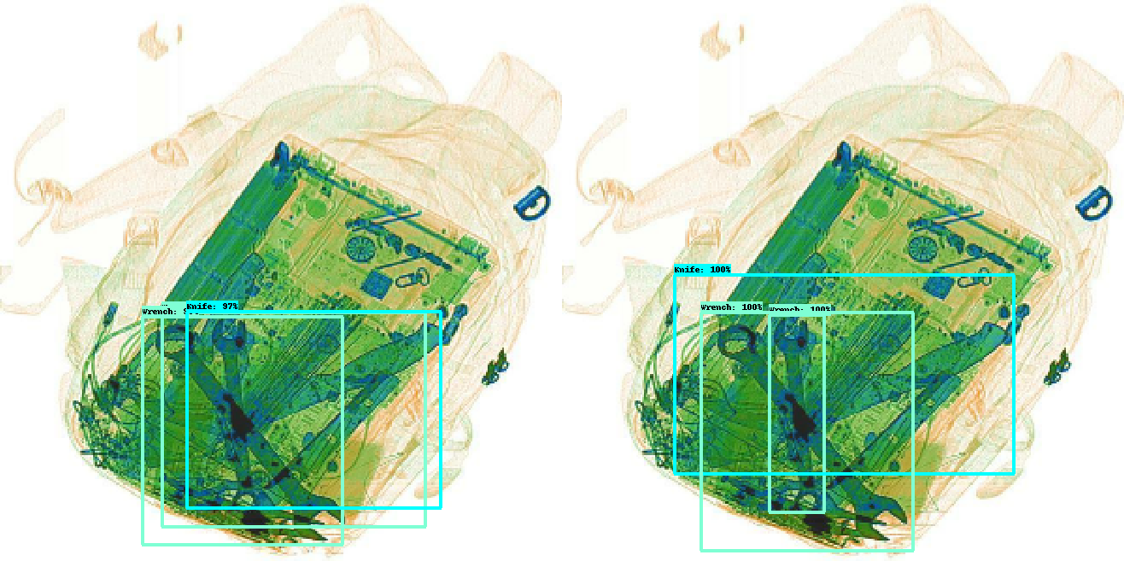
Prediction Ground Truth
Prediction Ground Truth

Slide 17
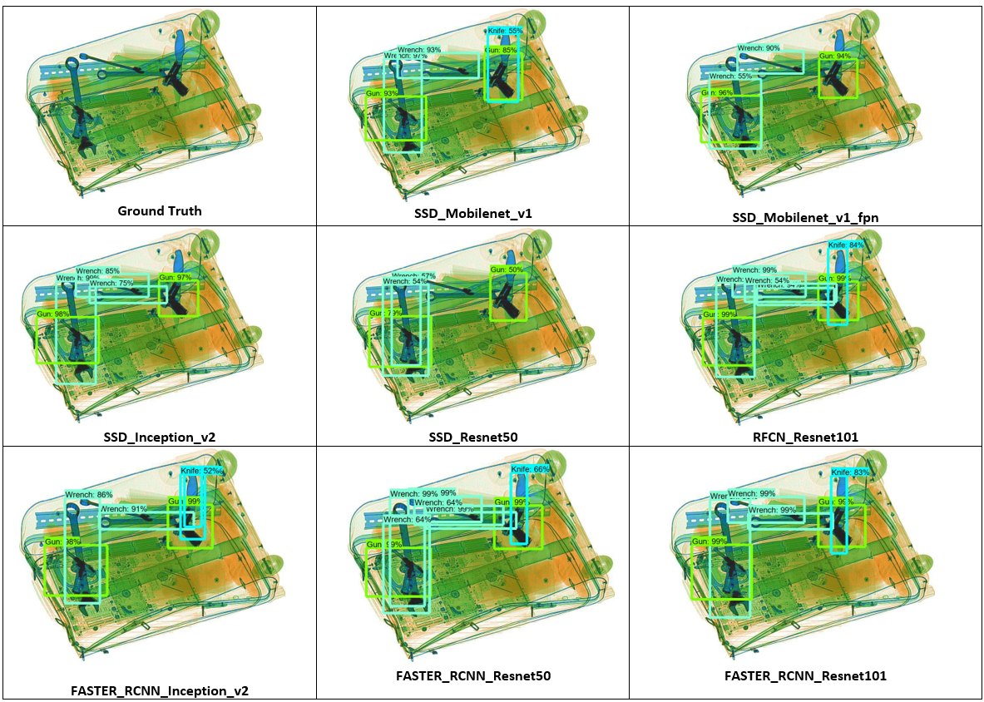

Slide 18
Observations
According to COCO metrics, SSD tends to be faster but performs far worse than Faster R-CNN and R-FCN; however, for our dataset, SSD can outperform those models with a similar backend.
Training time depends on configuration like optimization type, learning rate, batch size, and etc.
Always check training progress because the configuration from original research may not work with new dataset.

Slide 19
Future Works
Evaluate models with the whole dataset (including every Negative samples instead of using only their subsets)
Integrate Negative samples into training dataset
Compare models on time and accuracy(trade-off)

